Slide 1
Understanding the Competitor article
Sravan Kumar Borra

Slide 2
Data (Capstone)
Weather data
City- Aarhus in Denmark
Aim: To predict weather forecasting suitable for Smart City.
Duration of the dataset:
February 2014 - June 2014
August 2014 - September 2014
Contents of Data set: Dew Point, Humidity, Pressure, Temperature, Wind Direction, Wind Speed.

Slide 3
Competitor Article
Title: Comparative Study of ANFIS and ARIMA Model for Weather Forecasting in Dhaka
Data set: Ten years of weather data (2000-2009) of Dhaka
Aim of the article: Comparing ANFIS and ARIMA

Slide 4
Source
Source: IEEE Xplore Digital Library (IEEE.org)
Conference published in: Informatics, Electronics & Vision (ICIEV), 2013 International Conference
Date of the conference: 17-18 May 2013

Slide 5
Model
Model: ARIMA and ANFIS
Parameters used for comparing ARIMA and ANFIS
Mean Absolute Error (MAE)
Root Mean Square Error (RMSE)
R-square error and the Sum of Square Error (SSE).

Slide 6
Contents of the data set(Competitor)
Maximum Temperature
Minimum Temperature
These are the variables that are used for performing
ARIMA
ANFIS

Slide 7
ARIMA
Auto-Regressive Integrated Moving Average
Uses auto-regressive, integrated, moving-average
SPSS software (Statistical package for Social Sciences)

Slide 8
ARIMA (Forecasting Equation)
Used for forecasting a time series.
Competitors data is time series data of weather collection.
So they used forecasting equation of ARIMA.
A forecasting eq. of ARIMA --→ Simple linear equation which has dependent variables and errors.

Slide 9
Steps
Time series is deference- Stationary
Modelling the time dependence of the process which is stationary
Moving average is calculated
By combining all those we will get ARIMA

Slide 10
Steps in ARIMA
Time Series Deference
d=0 Observations Modelled directly
d=1 Difference b/w consecutive observations is modelled
Time dependence of stationary model
Autoregressive
Moving Average Terms
Time-varying covariates
Takes the previous errors as observation

Slide 11
Parameter Estimation in ARIMA
Non-Seasonal Lags |  | Estimated | Standard Error
 | AR1 | 1.553 | 0.026
 | AR2 | -0.559 | 0.025
 | MA | 0.867 | 0.017

Slide 12
ANFIS
Combination of fuzzy logic and Neural networks
ANFIS Editor GUI in the Fuzzy Logic Toolbox
ANFIS : Four inputs and one output

Slide 13
ANFIS Algorithm
It divides data into train set and testing set
Uses least squares and also gradient back propagation methods.
These methods will model the training data set.
After that it will check for test data if there is overfitting caused due to train data set.

Slide 14
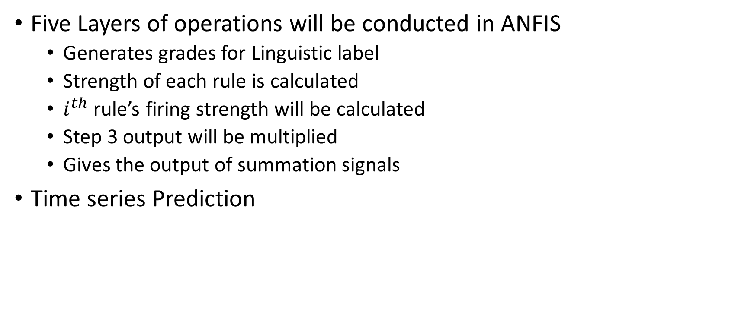
Steps
Five Layers of operations will be conducted in ANFIS
Generates grades for Linguistic label
Strength of each rule is calculated
$i^{th}$ rule’s firing strength will be calculated
Step 3 output will be multiplied
Gives the output of summation signals
Time series Prediction

Slide 15
Five Layers In ANFIS
Grades of Linguistic Label
Firing Strength of each rule
$i^{th}$ rule’s firing strength
𝑖^𝑡ℎ rule’s firing strength
Summation of all steps
Multiplying the results of step 3

Slide 16
Discussion and Result Analysis
95% to training the model and 5% to testing the model
ANFIS : Four inputs and one output
ARIMA: 2,0,1 Model
MAE, SSE, RMSE results were obtained for both ANFIS and ARIMA

Slide 17
Comparison Results
Criteria | ANFIS | ARIMA
SSE | 2.0151 | 0.2133
R^2 | -1.0151 | 0.7867
RMSE | 5.0808 | 1.6594
MAE | 4.1040 | 1.2008
According to the results, ARIMA capture the behavior of weather better than the ANFIS. This conclusion has been made based on the research done in article.

Slide 18
Idea for Capstone
The basic idea for this project is to predict the weather in a useful way to build a smart city.
Things to achieve:
Maximum and Minimum Temperatures
Forecasting the weather (Rainfall, Snowfall, Temperatures, Wind Speed Prediction)

Slide 19
Methods
Support Vector Machines
Decision trees
Neural Networks
We can also compare the results for each method and choose the best method for prediction.

Slide 20
Process
We have two sets of data. From February to June and August to September.
We can use one of the data sets as training data and use other data as testing data.
Accuracy is the primary goal for the prediction in this project.

Slide 21
Comparison
Capstone | Competitor Article
Model: SVM, Decision Trees Intend to Predict : Min. and Max. temperature, humidity, Pressure, Wind speed Tools : Zeppelin Python, R, Spark | Model: ARIMA and ANFIS Predicted: Min and Max Temperature Tools: SPSS Software and ANFIS Editor GUI MATLAB

Slide 22
Thank You

